Slide 1

Machine Learning-Based Vertical Acoustic Sensing for Human-Object Differentiation
Course: Machine Learning-Wise 25/26
Group: VER-2
Lecturer: Dr Andreas Pech
Presented by:
Saad Jamil 1427200
Kashif Hussain 1470503
Naila Shaheen 1439609
Fahad Jabbar 1502431
Zaka Ahmed 1436851

Slide 2
Table of Contents:
Introduction
Background
Methodology
Hardware Configuration
Machine Learning Models
Data Collection & Dataset Size
Software implementation
Implementation
Result
Conclusion

Slide 3
Introduction:
Robots, drones, and self-driving automobiles are examples of autonomous systems that rely on sensor technologies to sense and engage with their surroundings.
Occlusions, lighting circumstances, and privacy issues are some of the restrictions that optical sensors (like cameras) may face.
An affordable, reliable, and private substitute for environmental sensing is offered by ultrasonic sensors.
They are commonly used for distance measurement and obstacle detection in many autonomous applications.
The echo signals reflected from objects contain useful information that can be analyzed for object classification.
However, vertically mounted ultrasonic sensors generate complex and irregular echo patterns, making human–object discrimination difficult.
Noise, environmental reflections, and posture variations further increase the complexity of echo signals.
Machine learning techniques can analyze these complex patterns to improve human–object differentiation.

Slide 4
Background:
Robotics, automation, and intelligent systems all make extensive use of ultrasonic sensors for non-contact distance measuring.
Ultrasonic sensors operate using the pulse–echo principle, where sound waves are emitted and reflected signals are analyzed.
Traditional ultrasonic systems are primarily designed for range estimation and obstacle detection.
The shape, material, and structure of objects influence the reflected echo signals.
Humans and non-human objects produce different echo patterns due to body geometry and surface characteristics.
Most existing ultrasonic sensing systems use horizontally mounted sensors for detection tasks.
Vertically oriented ultrasonic sensors introduce new challenges because reflections become more complex and irregular.

Slide 5
Methodology:
Create a vertical acoustic detection system with hardware from Red Pitaya.
Generate controlled acoustic/ultrasonic signals using Red Pitaya DAC.
Transmit signals vertically and capture echo reflections from humans and objects.
Acquire reflected signals using a receiver and Red Pitaya ADC.
Use signal preparation, such as normalization and noise filtering.
Extract important parameters including amplitude, frequency, and time-of-flight.
Build a labelled dataset of human and object echo signals.
Train a machine learning model to differentiate human and object reflections.
Test and validate the model for classification accuracy.
Put the real-time human-object distinction system into action.

Slide 6
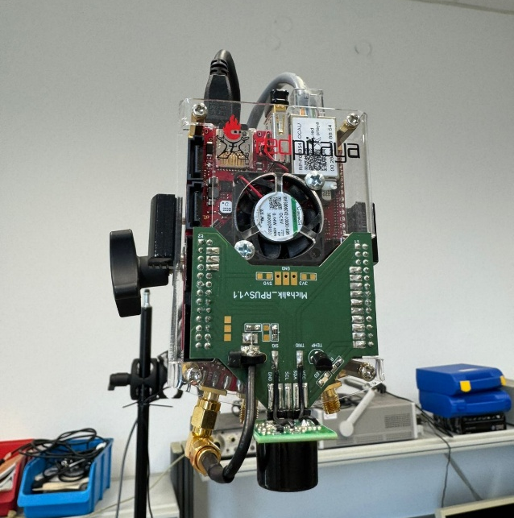
Hardware Configuration:
Red Pitaya is used as the core hardware platform for signal generation, acquisition, and processing in the acoustic sensing system.
Dual-core ARM Cortex-A9 with Zynq FPGA.
14-bit ADC (125 MS/s) for the capture of echo signals.
14-bit DAC (125 MS/s) for acoustic signal generation.
512 MB RAM for data processing.
Ethernet communication with the host computer.
GPIO interfaces for sensor integration.
Linux-based platform for signal processing and ML implementation.
Ultrasonic transducer connected for signal transmission.

Slide 7
Machine Learning Models:
The following machine learning models are utilized in this project to analyze acoustic signals and enable effective human–object differentiation:
Support Vector Machines (SVM)
Random Forest (RF)
Convolutional Neural Networks (CNN)
Temporal Convolutional Networks (TCN)
Convolutional–Transformer Hybrid Models
Time Series Transformer

Slide 8
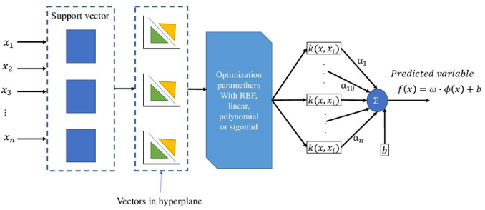
Support Vector Machines (SVM):
A supervised machine learning approach for pattern detection and classification is called Support Vector Machine (SVM).
It operates by determining the best hyperplane to divide data points into distinct classes.
Support vectors, or the crucial data points nearest to the decision boundary, are the algorithm's main focus.
To increase classification accuracy, SVM seeks to maximize the margin between several classes.
It works well with small datasets and high-dimensional data.

Slide 9
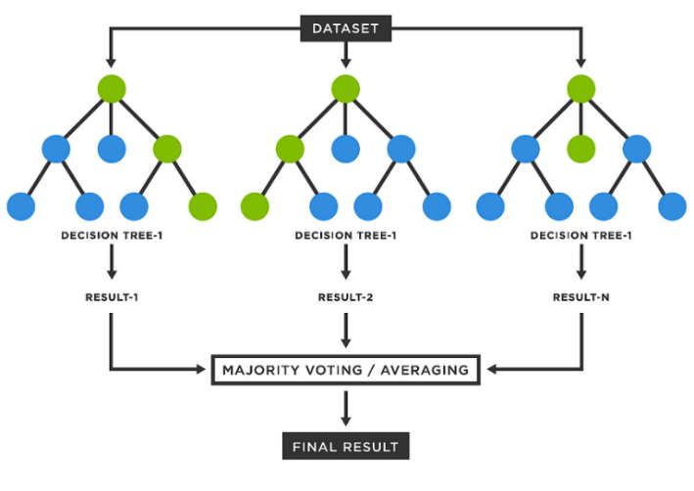
Random Forest (RF):
A supervised machine learning technique for classification and regression tasks is called Random Forest (RF).
It works by creating multiple decision trees during training and combining their results.
Each tree is trained on random subsets of the data and features, which improves model diversity.
Either majority voting (classification) or averaging (regression) is used to arrive at the final forecast.
Overfitting is lessened and overall prediction accuracy is increased via Random Forest.

Slide 10
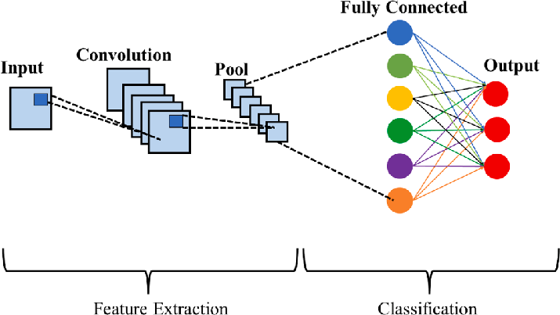
Convolutional Neural Networks (CNN):
Convolutional Neural Networks (CNN) are deep learning models designed for automatic feature extraction and pattern recognition.
CNNs use convolution layers to detect important features from input data such as patterns or signal structures.
Pooling layers reduce data size and help retain the most important information.
The extracted features are passed to fully connected layers for final classification.
CNNs are very good at analyzing spectrograms, signals, and images.

Slide 11
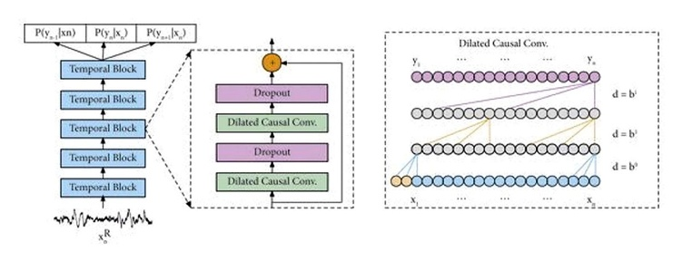
Temporal Convolutional Networks (TCN):
Temporal Convolutional Networks (TCN) are deep learning models designed for time-series and sequential data analysis.
By using causal convolutions, TCN makes sure that predictions are solely based on historical data.
It effectively captures long-range temporal dependencies by using dilated convolutions.
Residual connections help maintain stable training and improve learning performance.
TCN provides parallel computation and faster training compared to traditional recurrent models.

Slide 12
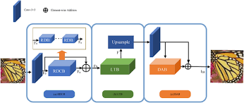
Convolutional–Transformer Hybrid Model:
Combine Convolutional Neural Networks (CNNs) with Transformer architectures.
CNN layers extract local spatial features from acoustic signal representations (e.g., spectrograms).
Transformer modules apply self-attention mechanisms to capture global relationships and long-range dependencies.
Improves feature representation and model performance by leveraging both local and global information.

Slide 13
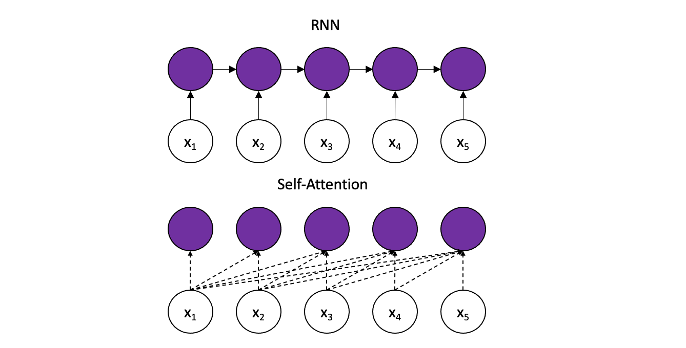
Time Series Transformer:
Time Series Transformer Models are deep learning architectures designed to analyze and predict time-series data.
They use self-attention mechanisms to capture relationships between different time steps in a sequence.
Able to learn long-range temporal dependencies and complex patterns in sequential data.
Use positional encoding to preserve the order of time steps in the input sequence.
Allow parallel processing of sequence data, improving computational efficiency.

Slide 14

Data Collection & Dataset Size:
Staged Acquisition: Incremental sessions to capture environmental variability
Dataset Growth:
Initial Phase: 1500 baseline samples.
Final Stage: ~50000 total measurements.
Echo Characteristics: Human reflections appear broader and irregular, whereas objects yield sharper reflections.

Slide 15
Software Implementation:
To reproduce the experiments:
Ensure the Python environment provides at least:
pandas, numpy, scikit-learn, matplotlib, tensorflow (with Keras), and openpyxl.
Open VER_pipeline.ipynb in JupyterLab, Jupyter Notebook, VS Code, or Cursor.
Execute the cells sequentially under the section “VER Human+Object Preparation Pipeline (Dual‑Class)”, covering:
Data loading, concatenation, and header application.
Column selection and construction of X and y.
Train/test split and feature scaling.
Training and evaluation of ML Models:
Support Vector Machines (SVM)
Random Forest (RF)
Convolutional Neural Networks (CNN)
Temporal Convolutional Networks (TCN)
Convolutional–Transformer Hybrid Model
Time Series Transformer
The final summary and visualization cell.
Upon completion, the notebook provides:
Confusion matrices and classification reports for each model.
A consolidated table of accuracy and macro F1‑scores.
Visual comparisons that show different designs, given the ultrasonic sensor data, are best suited for discriminating between humans and objects.

Slide 16
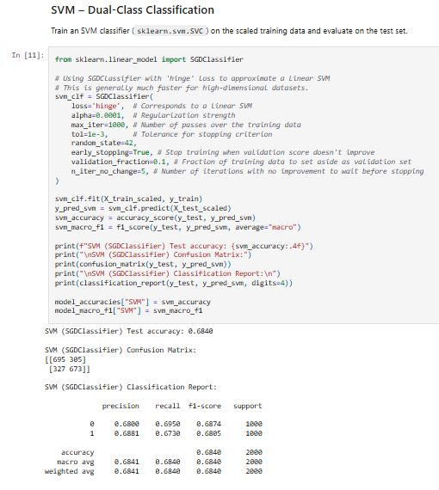
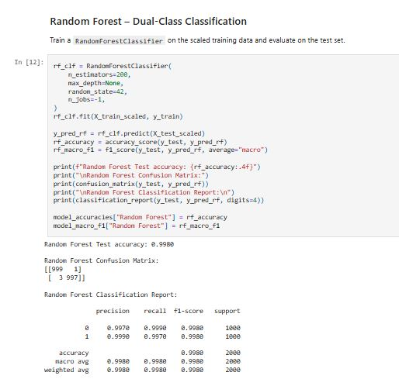
Implementation Methods:

Slide 17
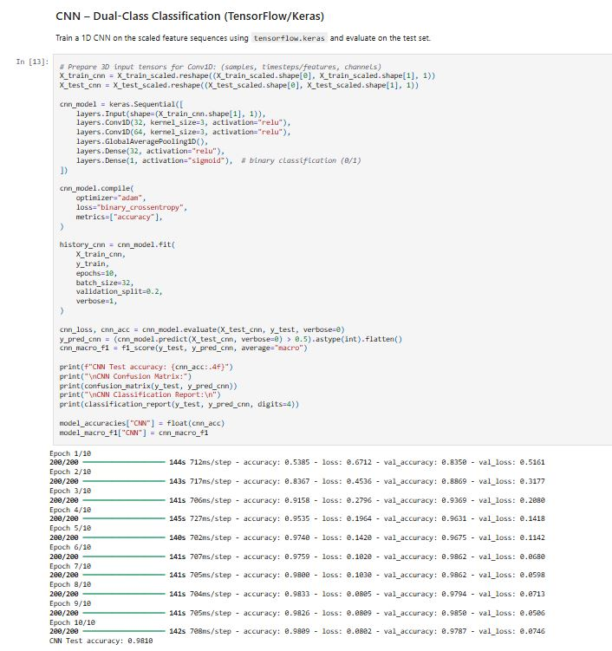
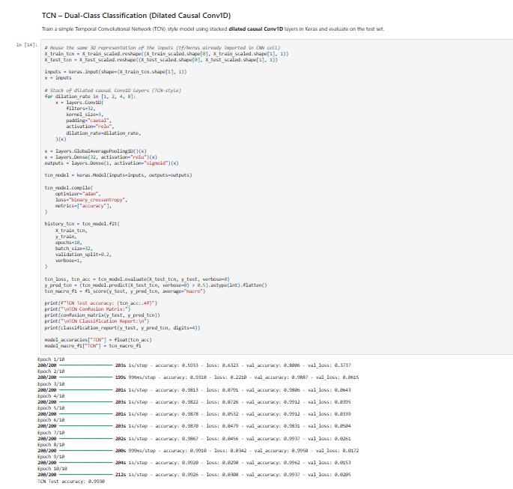
Implementation Methods:

Slide 18
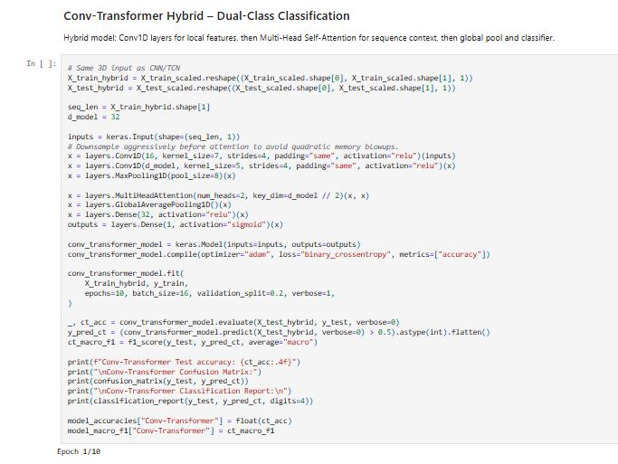
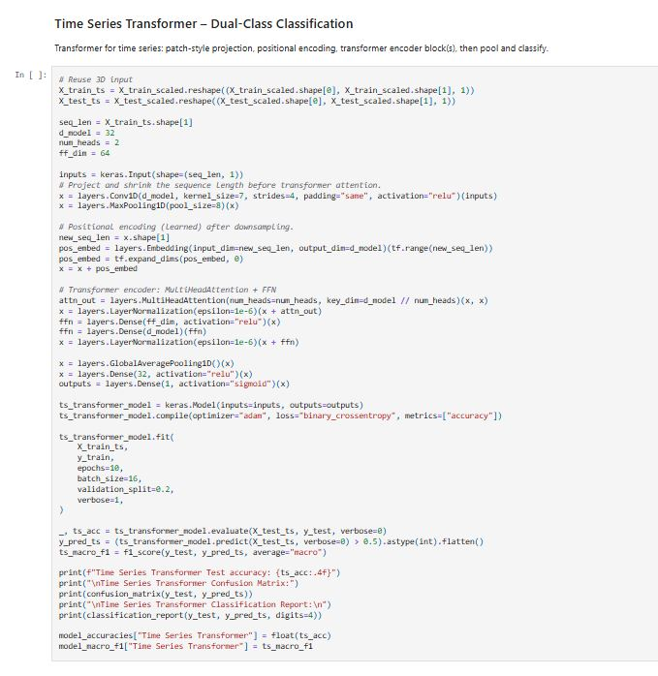
Implementation Methods:

Slide 19
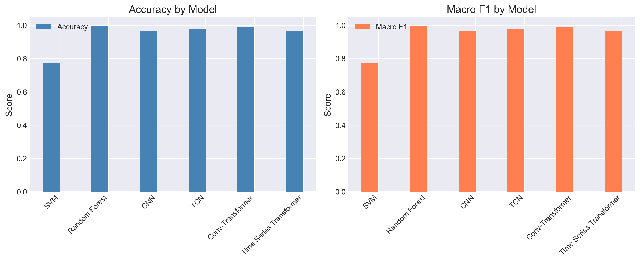
Implementation Calculating Accuracy:

Slide 20
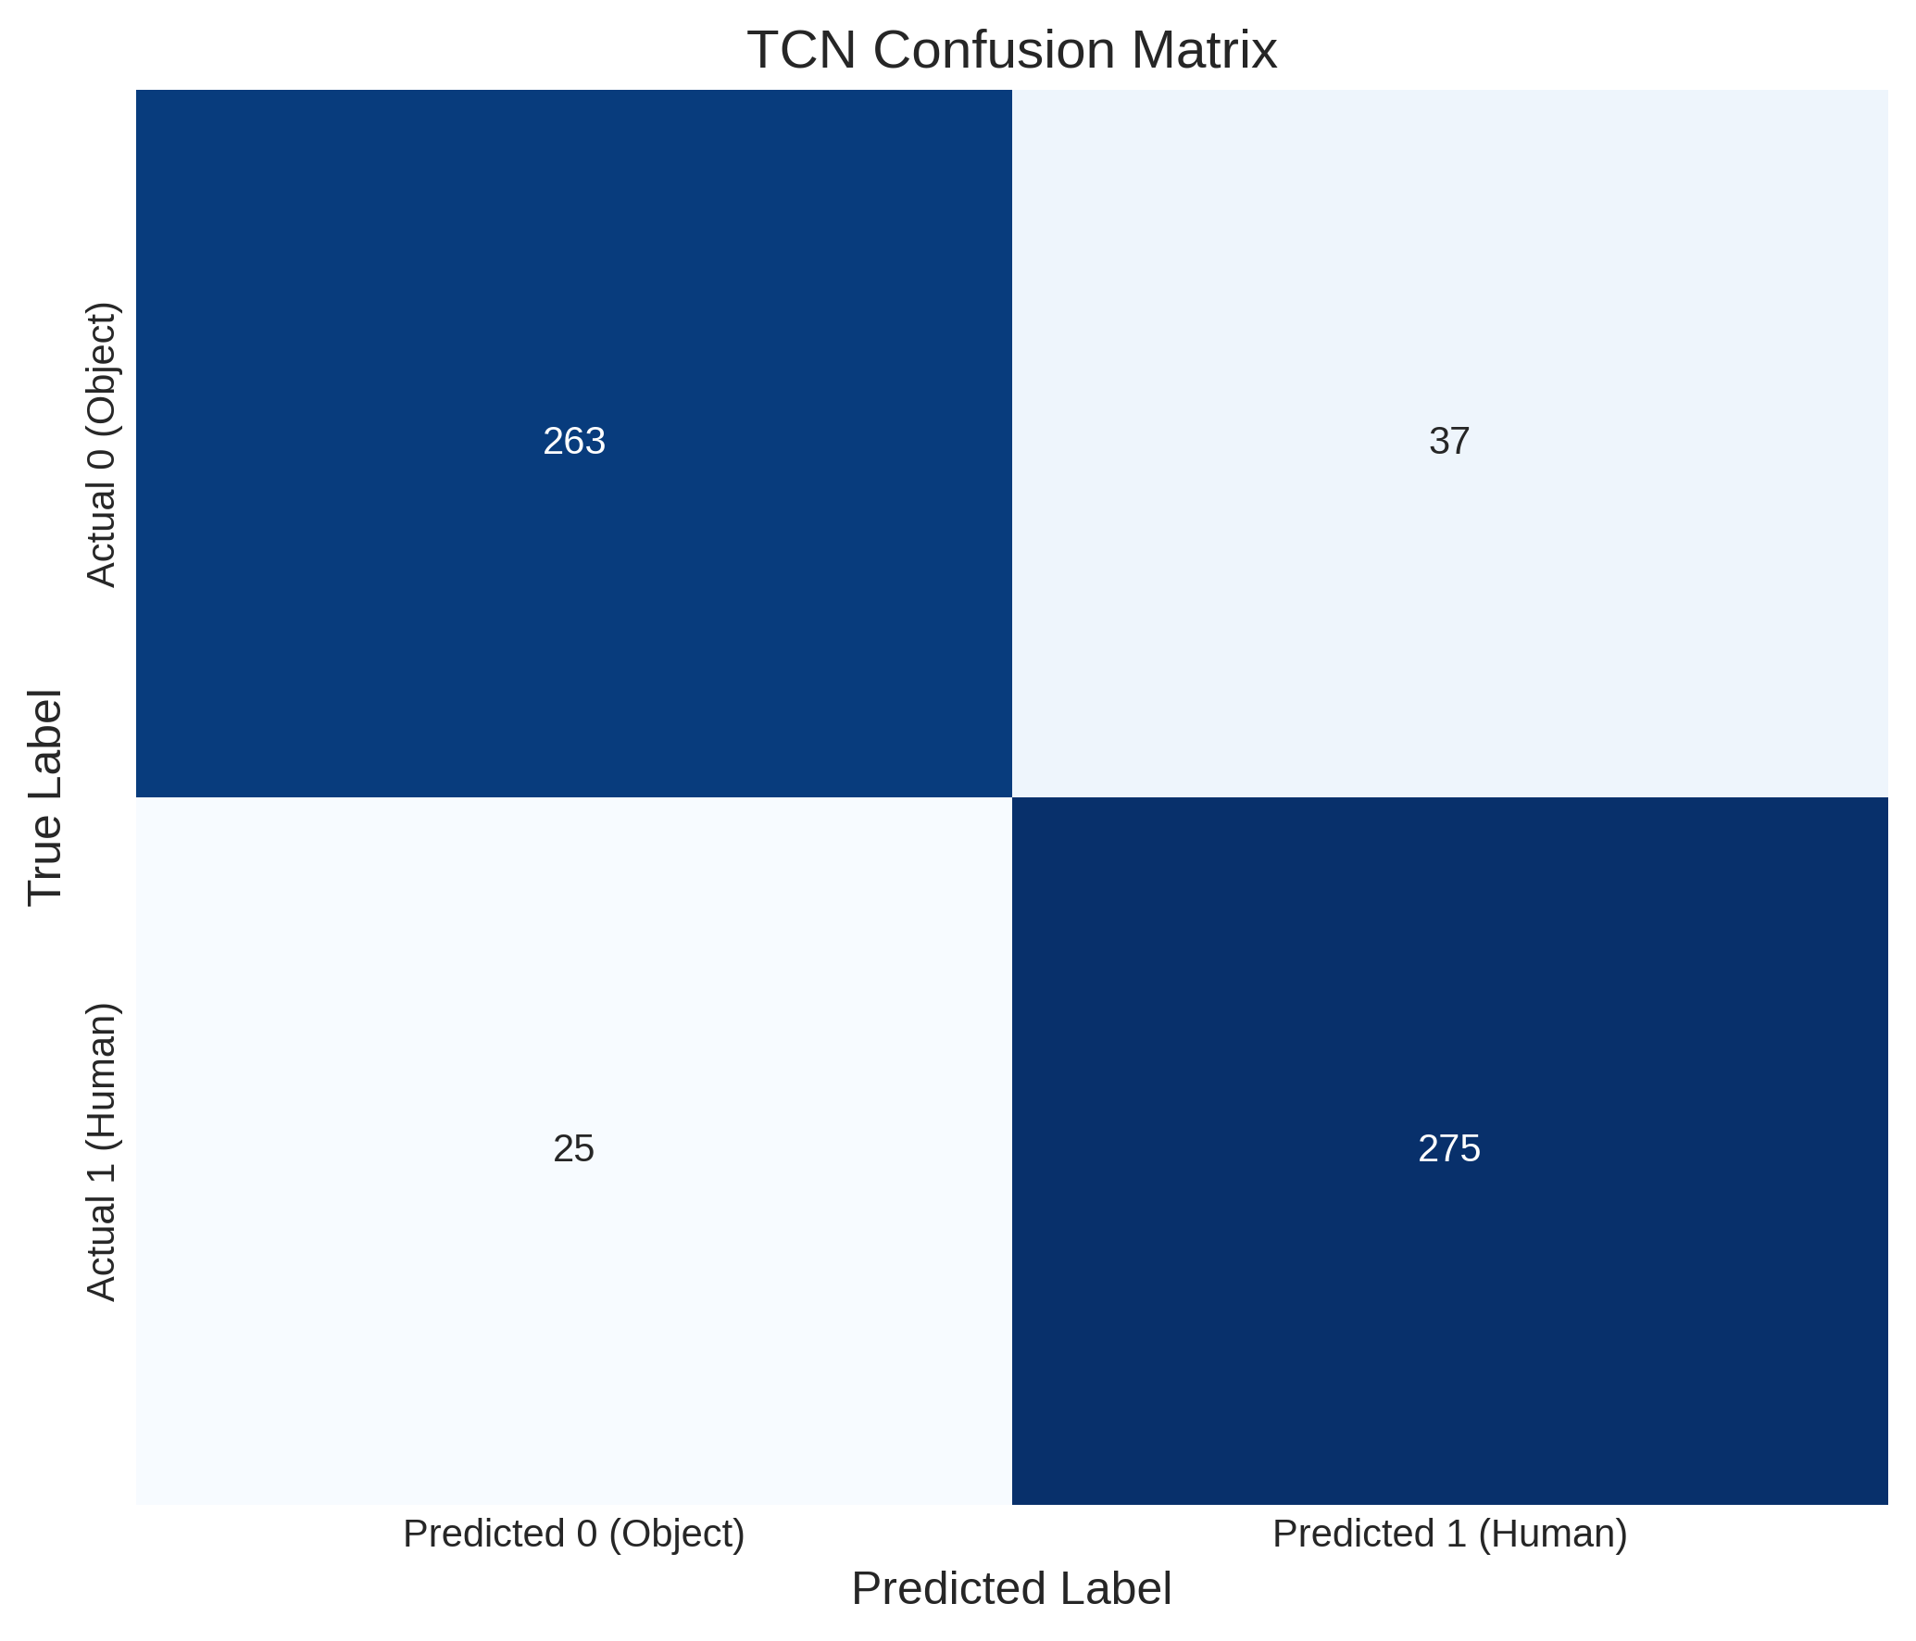
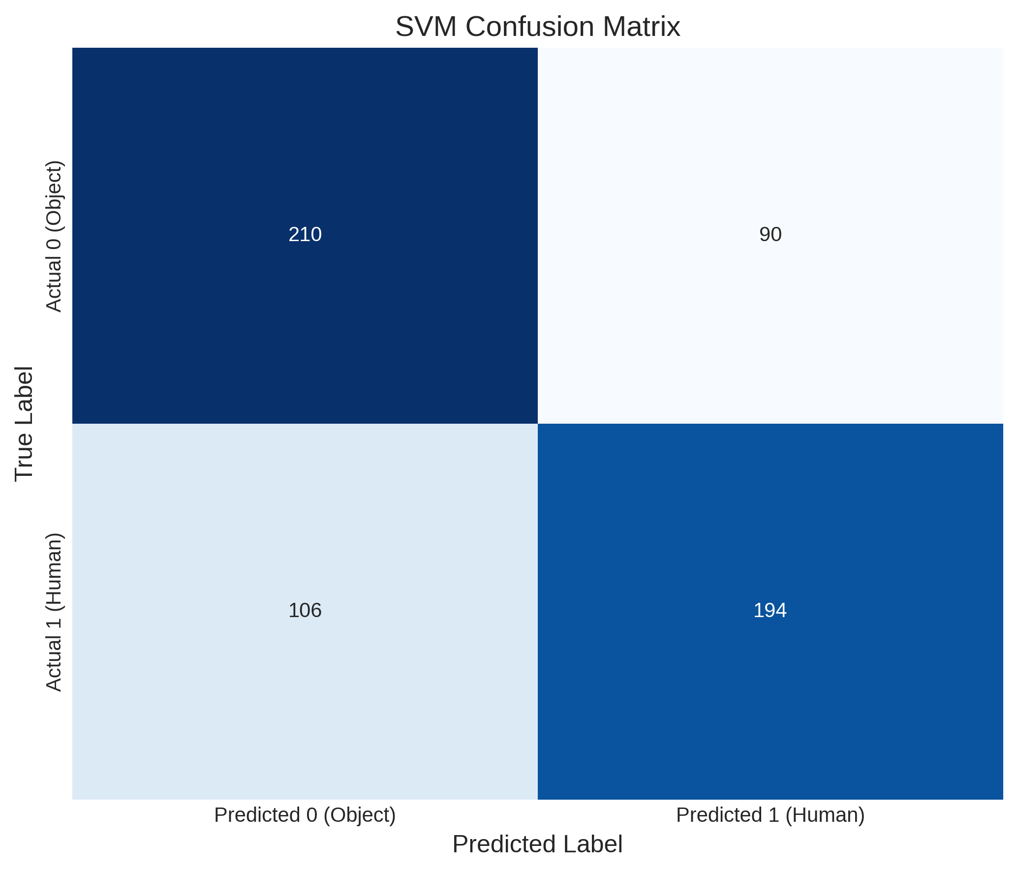
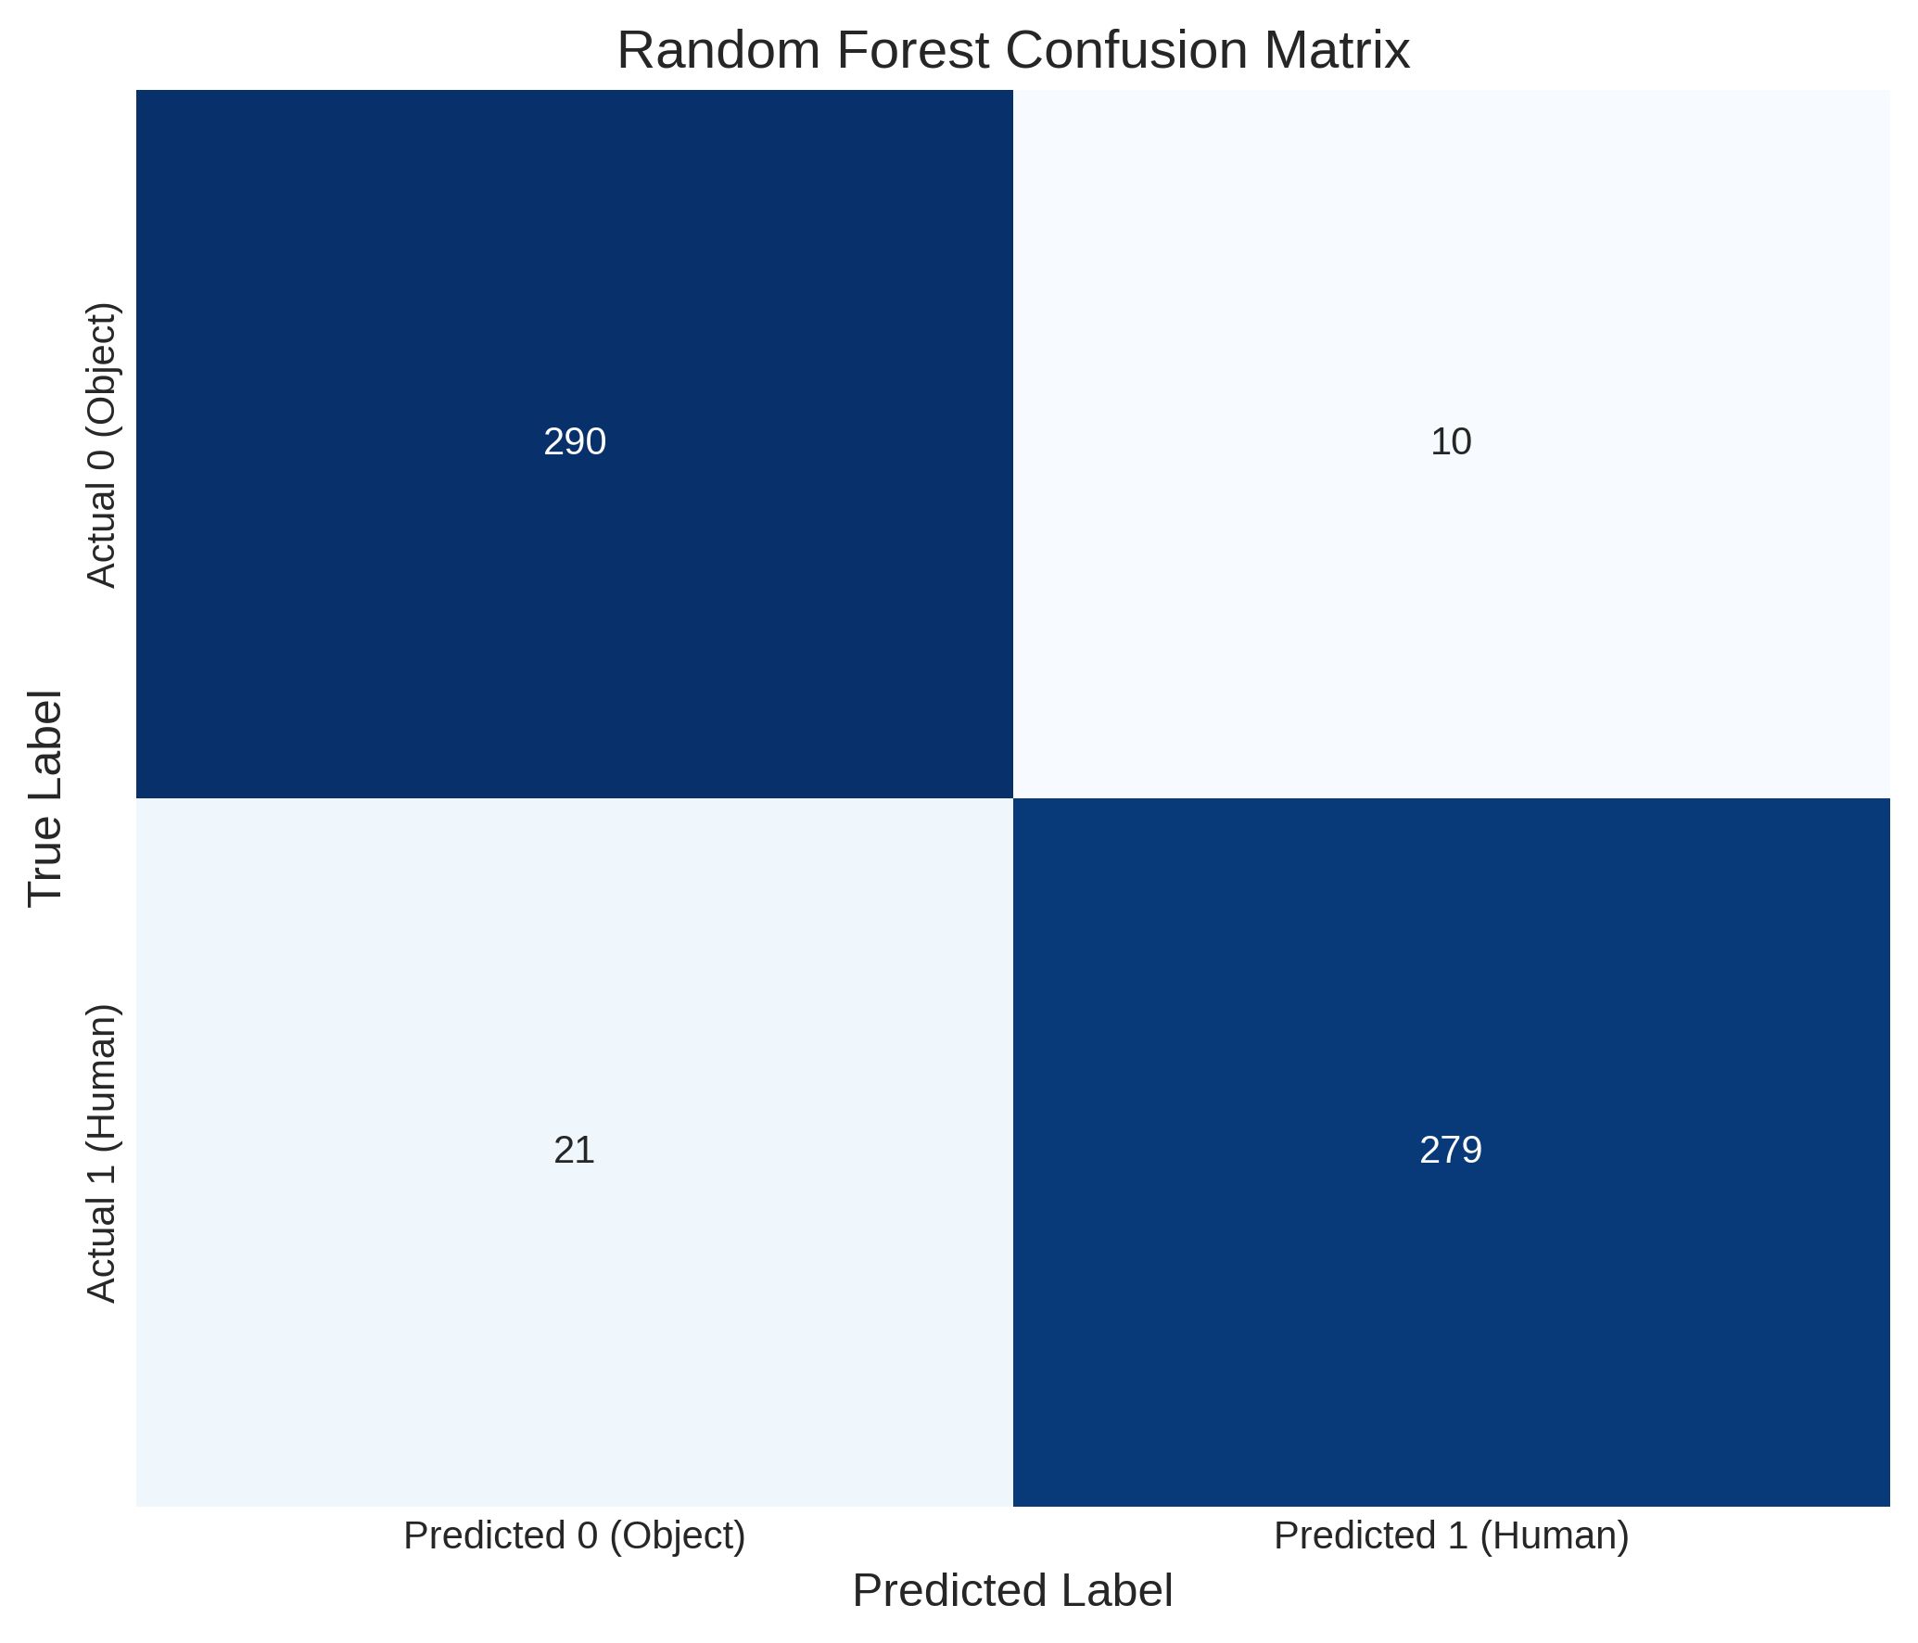
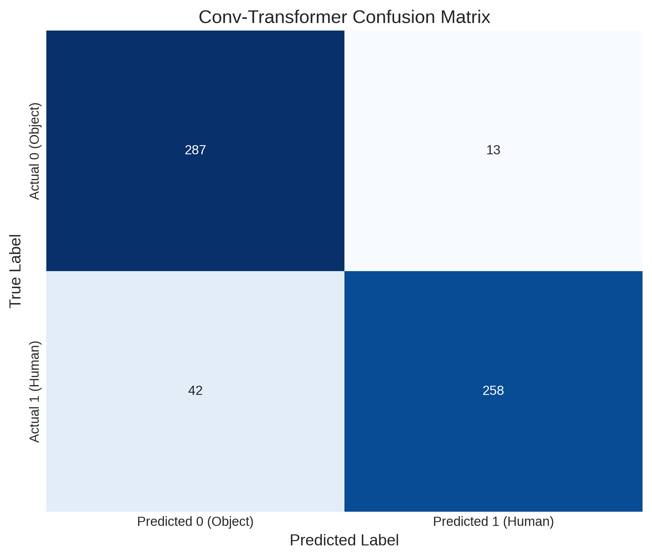
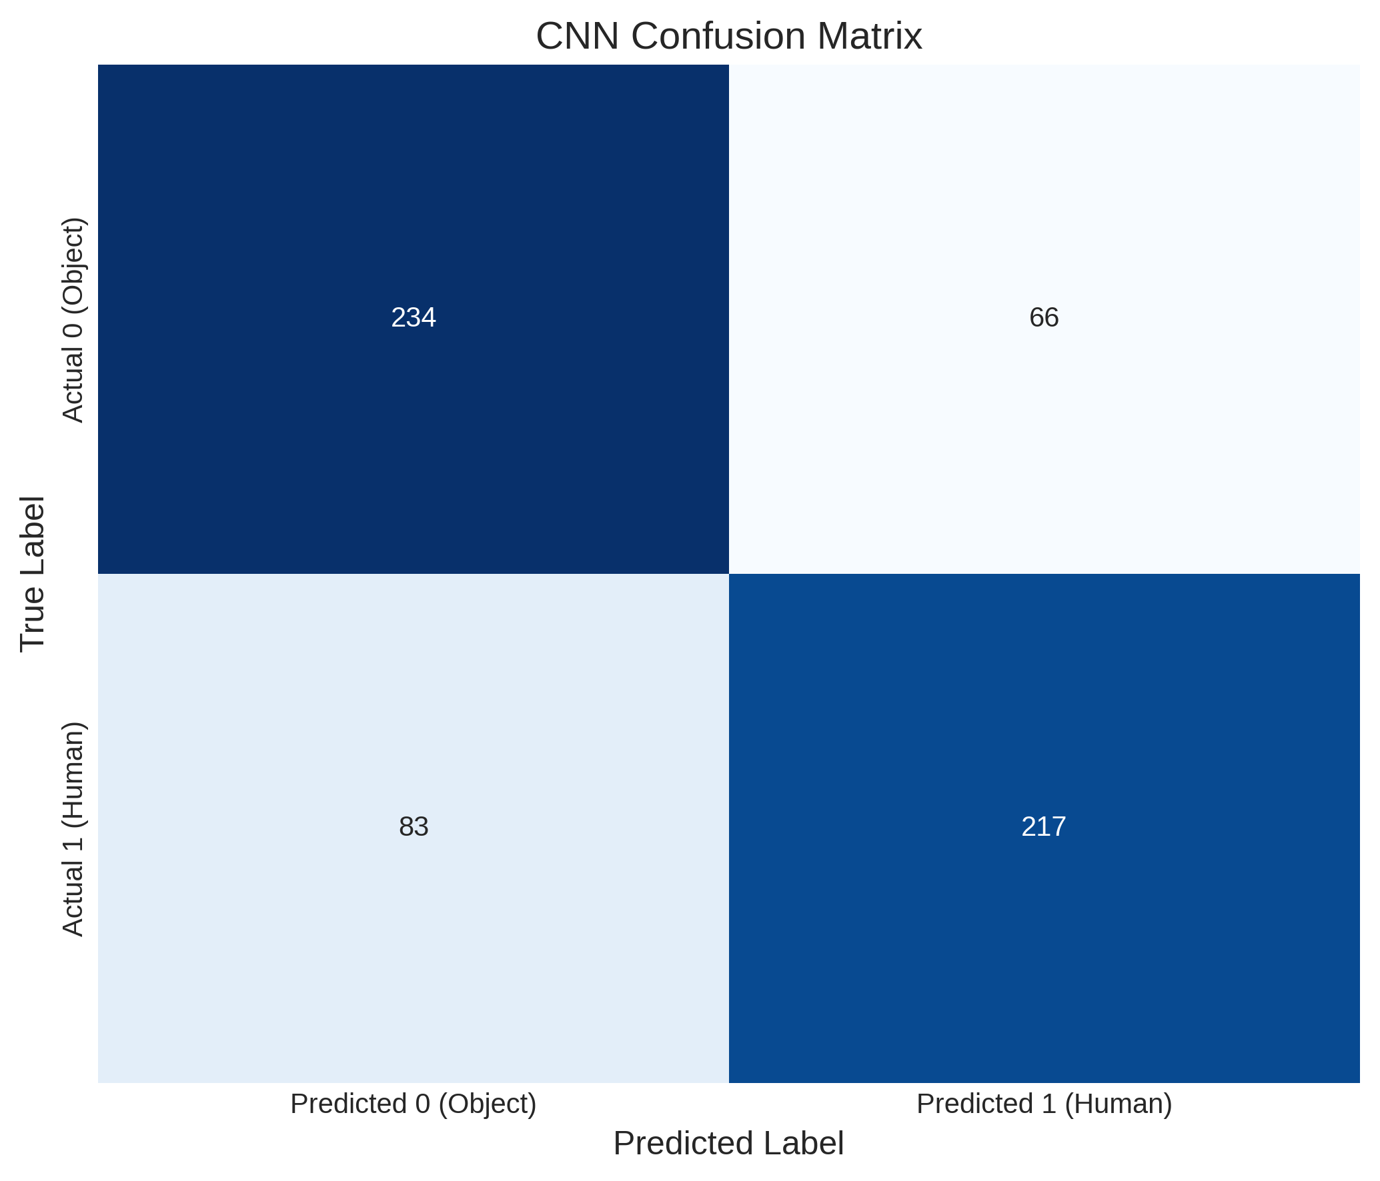

Results:

Slide 21
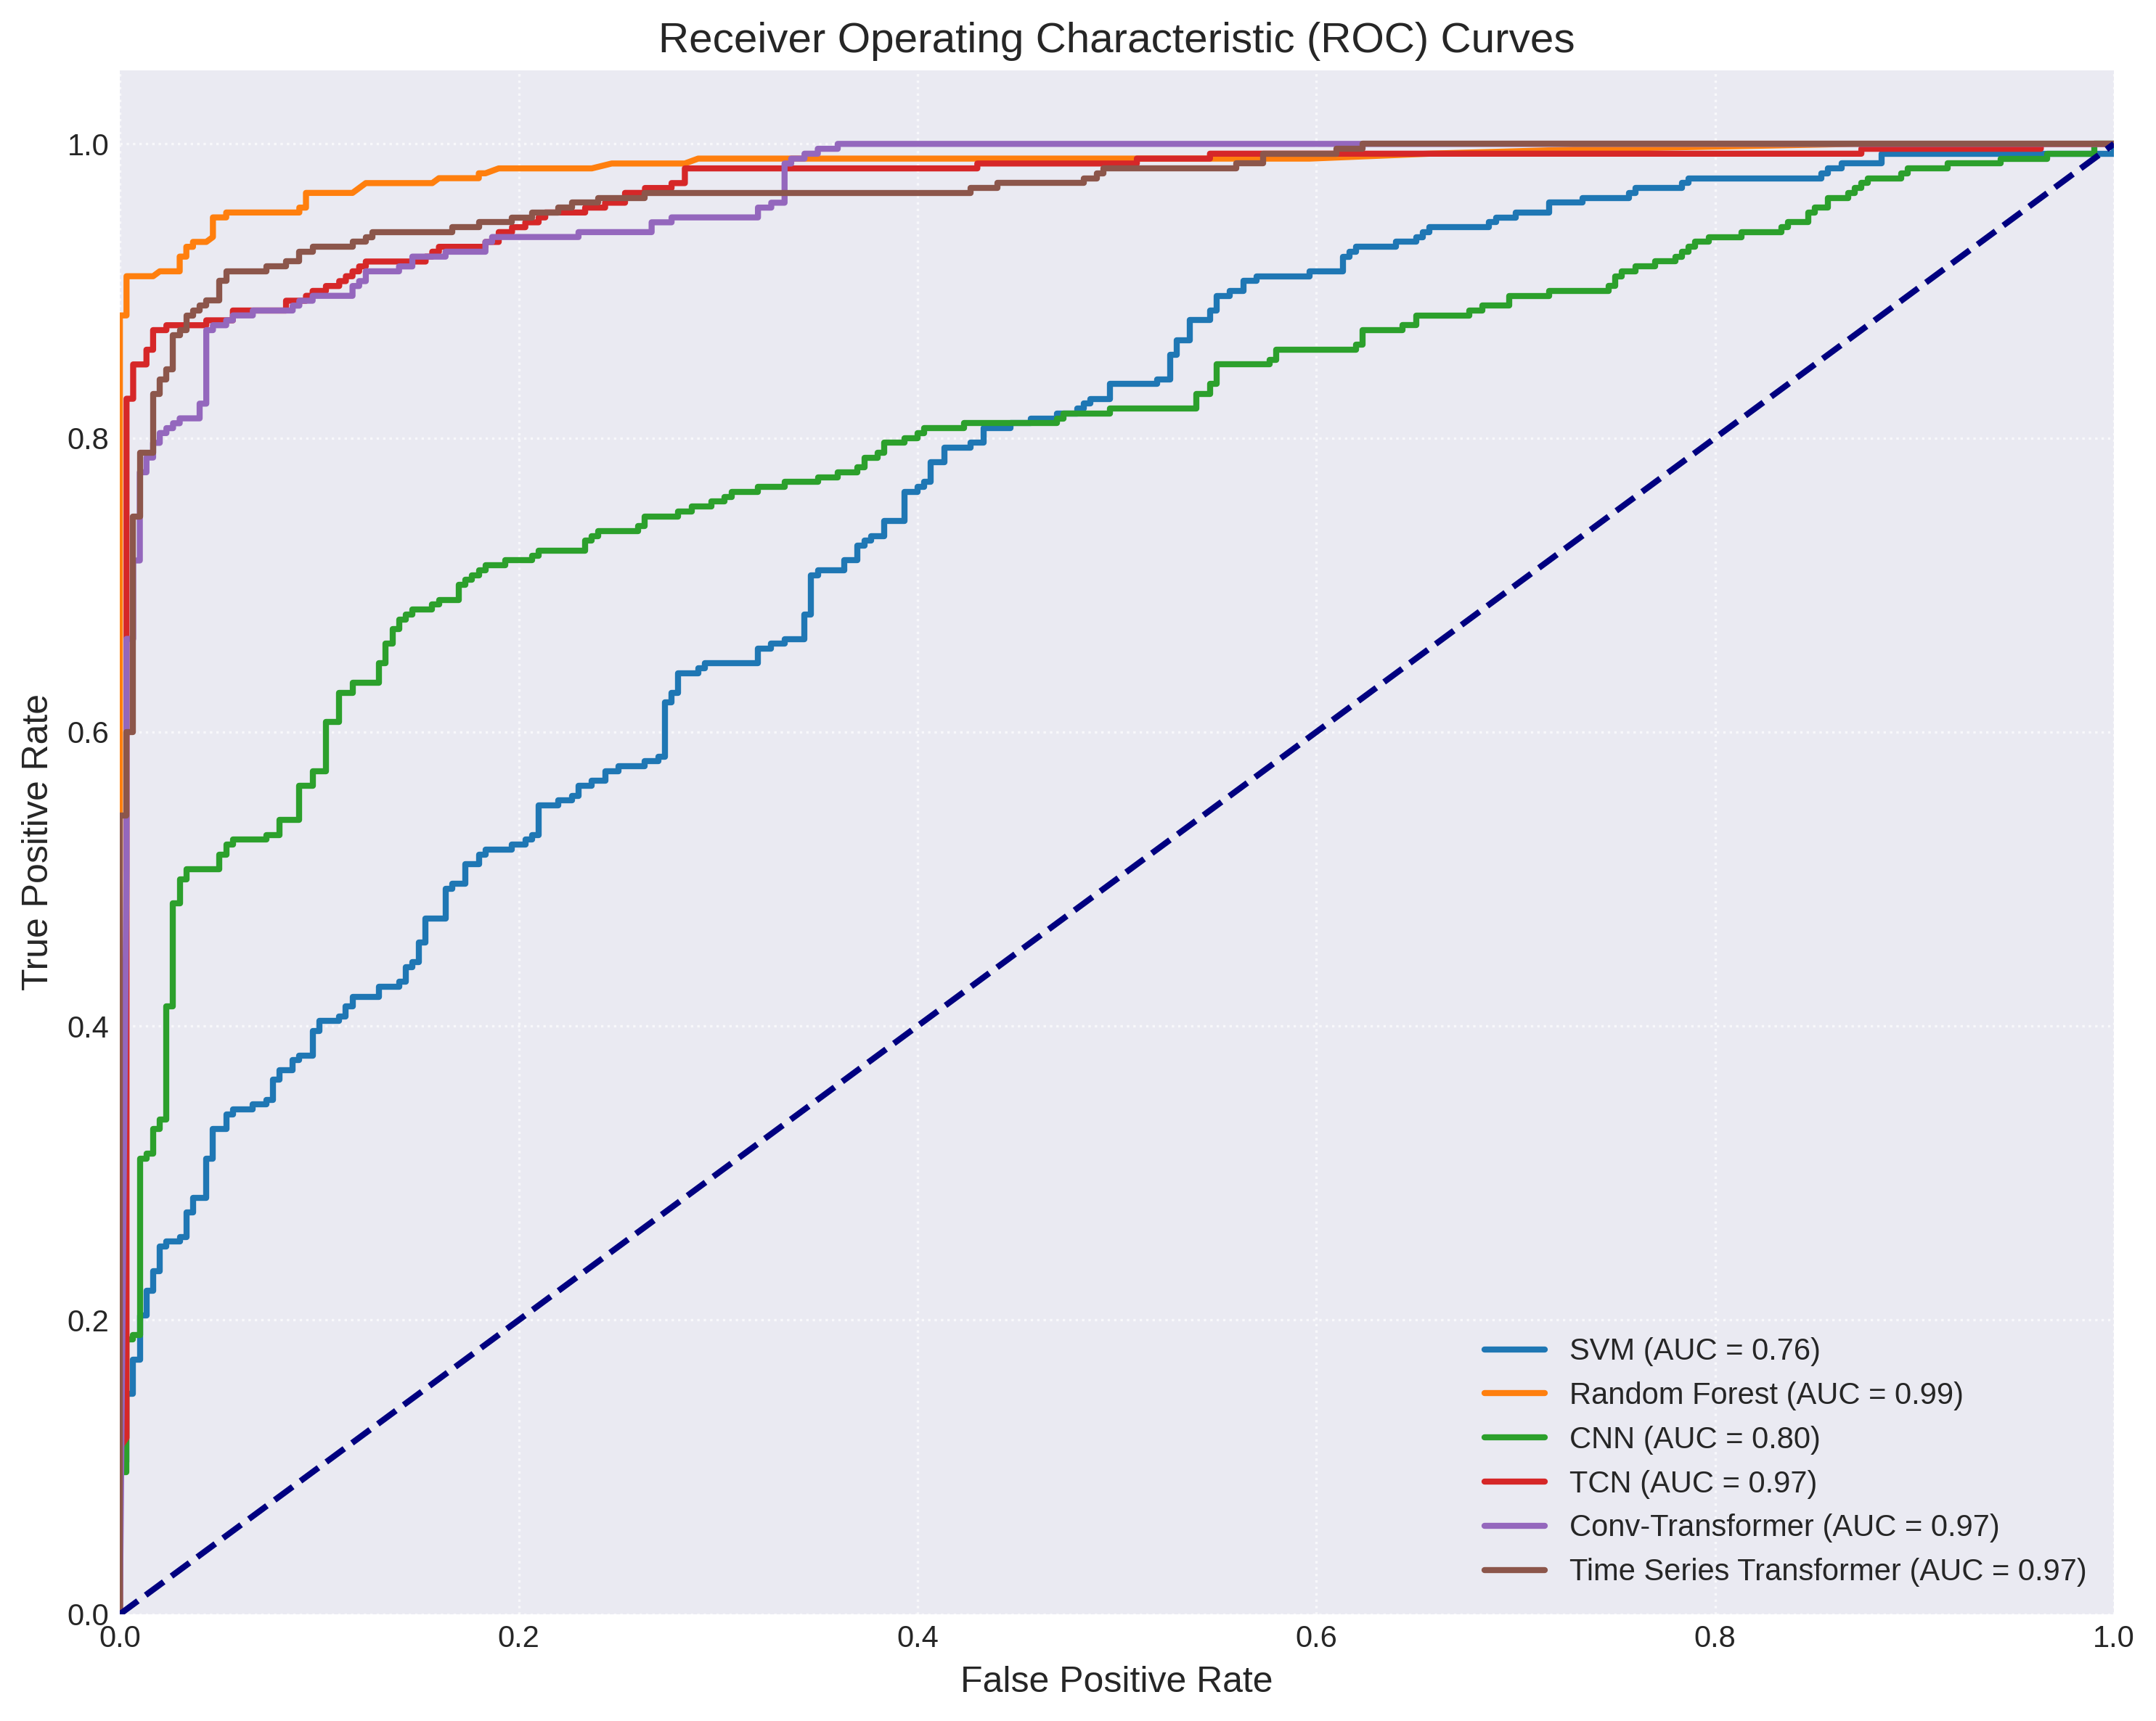
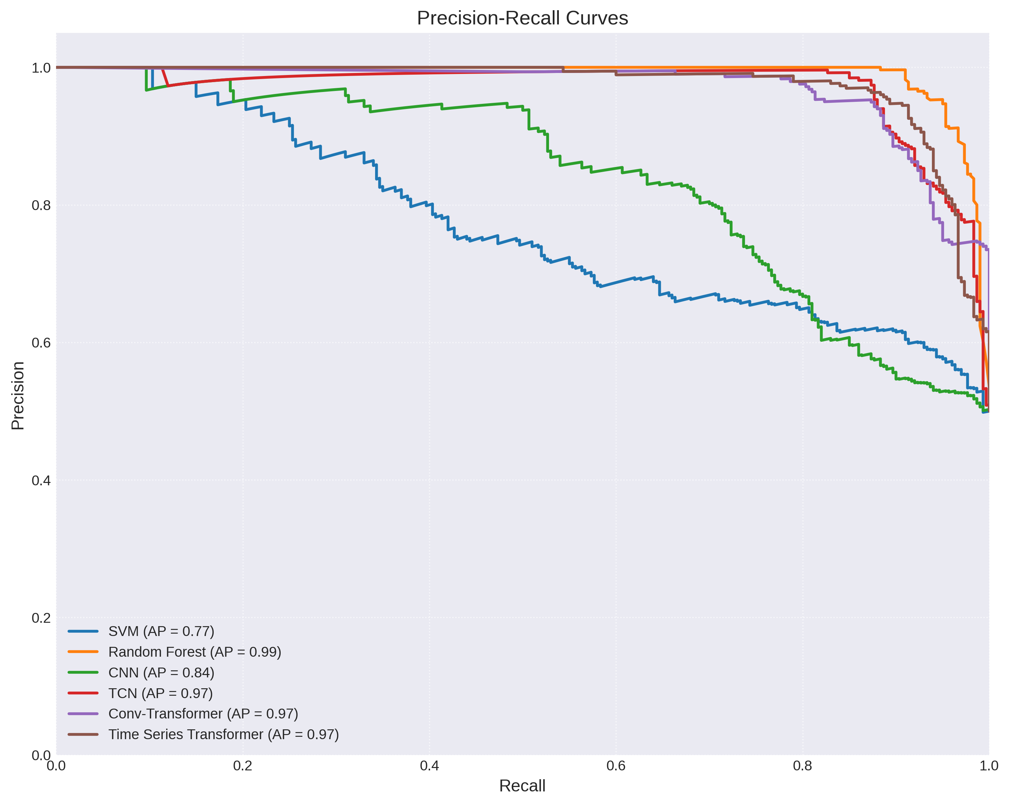
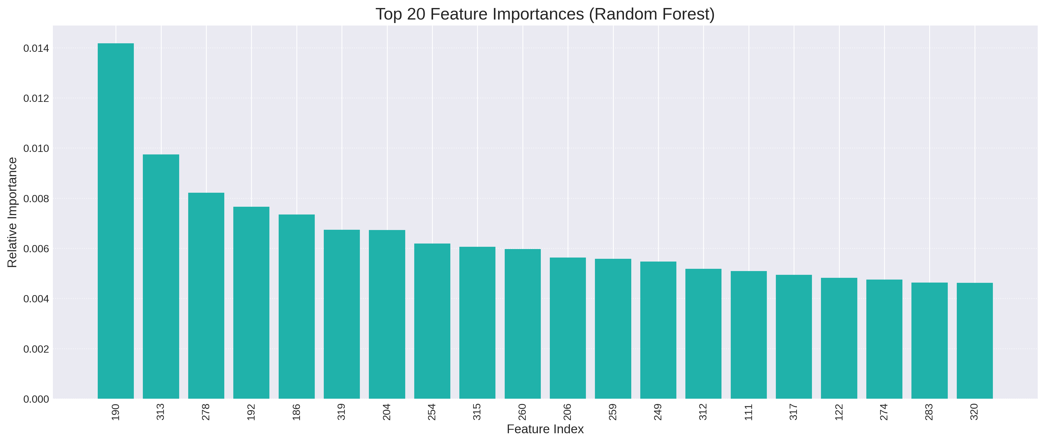
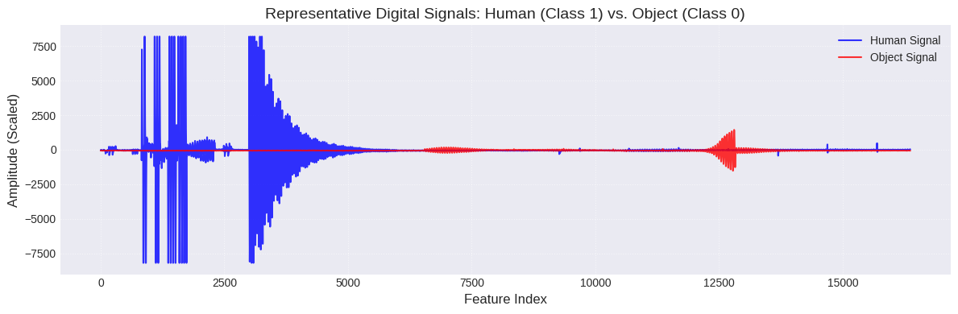
Results:

Slide 22
Conclusion:
This project improves human–object detection using the FIUS ultrasonic sensor with optimized signal processing and machine learning.
Dataset size significantly influences model performance, especially for deep learning models.
Random Forest provides a strong and stable baseline, achieving up to 99.9% accuracy across different dataset sizes.
Deep learning models improve substantially with larger datasets, showing a strong performance gain when scaling from 3,000 to 30,000 samples.
The Temporal Convolutional Network (TCN) performed best among neural networks by effectively learning temporal patterns in high-dimensional (25,000-feature) signals.
TCN achieved 99.7% accuracy with the largest dataset due to its dilated causal convolution structure.
Support Vector Machines (SVM) showed limited scalability and performance plateau in this high-dimensional task.
The system shows strong potential for applications in robotics, automation, security, and smart environments.
Future work includes deep learning improvements, adaptive models, and multi-sensor integration.

Slide 23
Thank You!

